Slide 1
Lecture 4: Recurrent Neural Networks and LSTM
ITA17 Natural Language Processing with Deep Learning
Yuichi Yaguchi

Slide 2
Agenda
Statistical Model to Neural Model
Recurrent Neural Network: Vanilla RNNs
LSTM Networks
Gated Recurrent Units & Variants

Slide 3
Recap: Language Model
Model to assign scores to sentences
Related: the task of predicting the next word
Sentence: w₁, w₂, … w_{n}
Break sentence probability down with chain rule (no loss of generality)

Slide 4
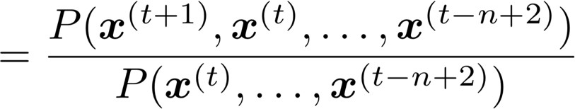
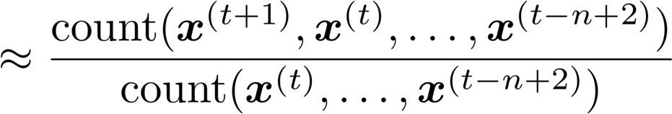
Recap: n-gram Language Model
First we make a Markov assumption: 𝑥^{(𝑡+1)} depends only on the preceding n-1 words
n-1 words
(assumption)
prob of a n-gram
(definition of conditional prob)
prob of a (n-1)-gram
Question: How do we get these n-gram and (n-1)-gram probabilities?
Answer: By counting them in some large corpus of text!
(statistical approximation)

Slide 5
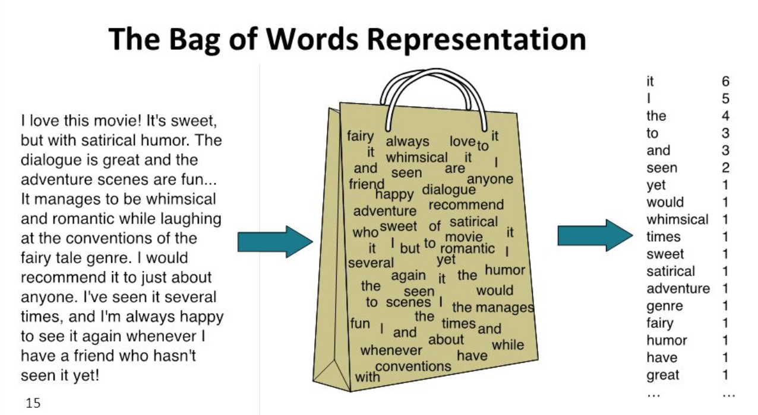
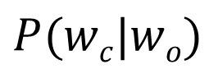
Recap: Statistical Language Model
Bag-of-Word Model – co-occurrence/collocation in a sentence (or window)
$$P(wc|wo)$$

Slide 6
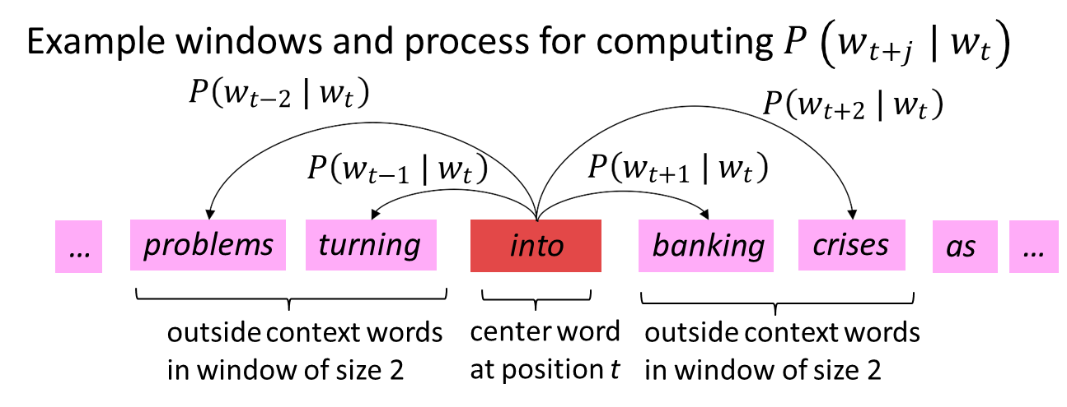
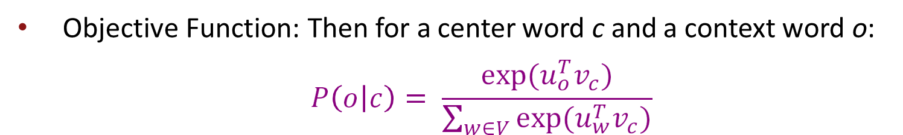
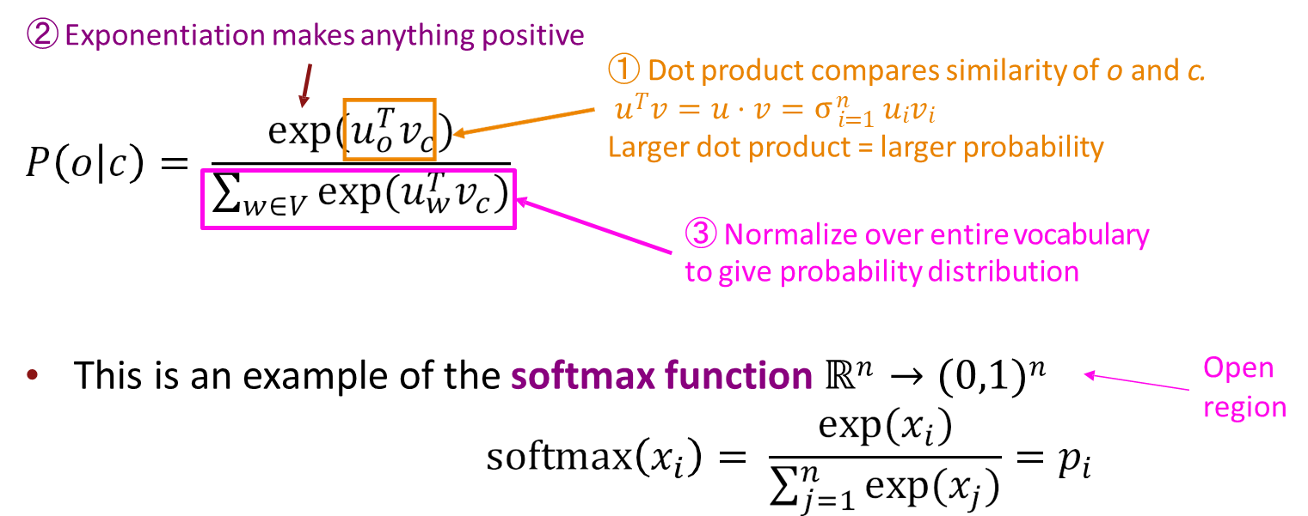
Recap: Statistical Language Model
Bag-of-Word Model / Word2Vec

Slide 7
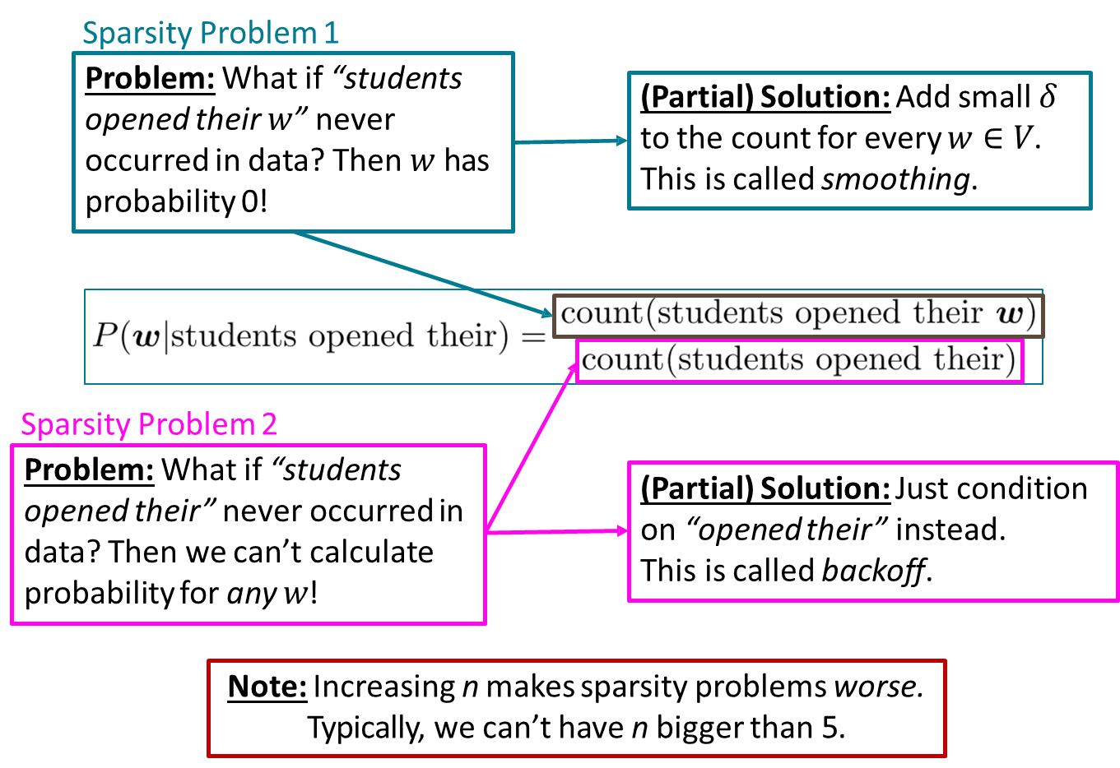
Sparsity Problems with n-gram Language Models

Slide 8
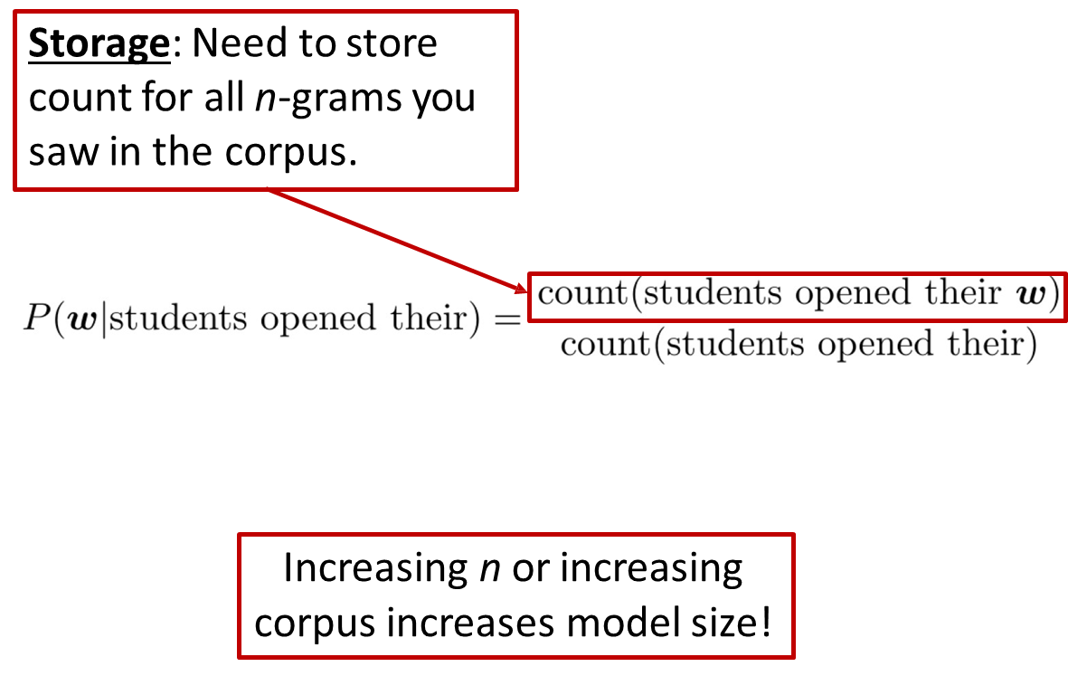
Storage Problems with n-gram Language Models

Slide 9
n-gram Language Models in practice
You can build a simple trigram Language Model over a
1.7 million word corpus (Reuters) in a few seconds on your laptop*
Business and financial news
today the
get probability distribution
company | 0.153
bank | 0.153
price | 0.077
italian | 0.039
emirate | 0.039
Sparsity problem: not much granularity in the probability distribution
…
Otherwise, seems reasonable!
* Try for yourself: https://nlpforhackers.io/language-models/

Slide 10
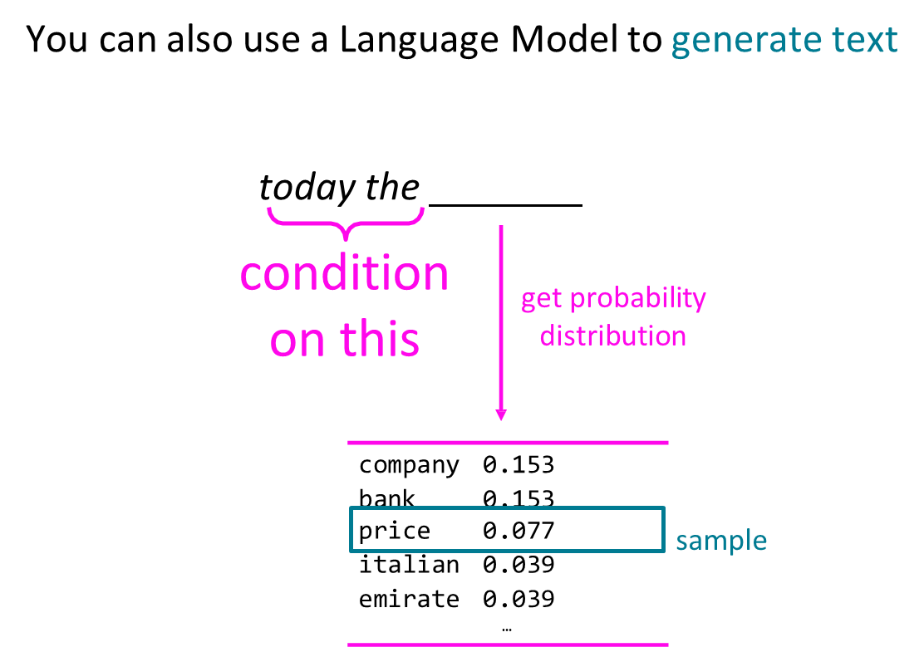
Generating text with a n-gram Language Model

Slide 11
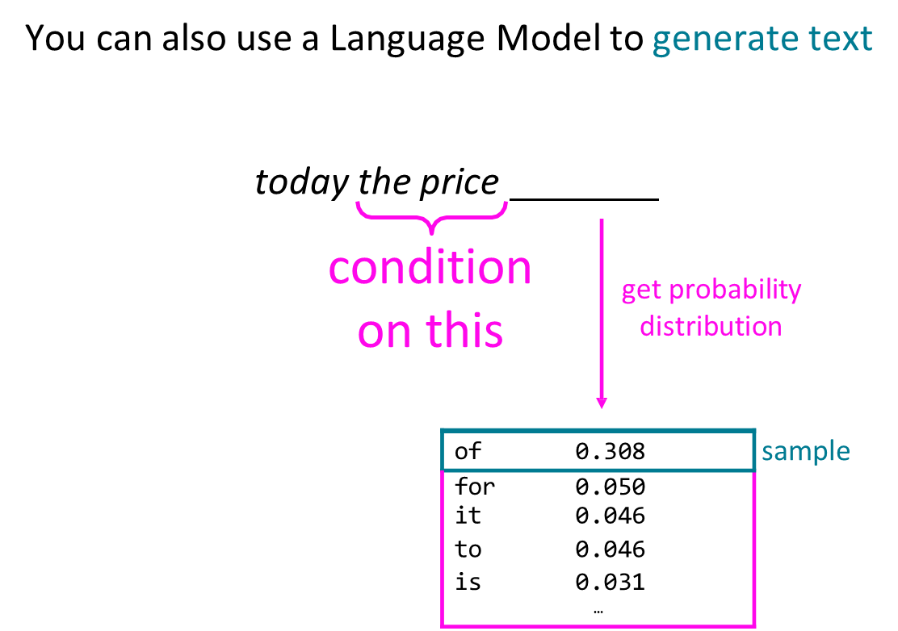
Generating text with a n-gram Language Model

Slide 12
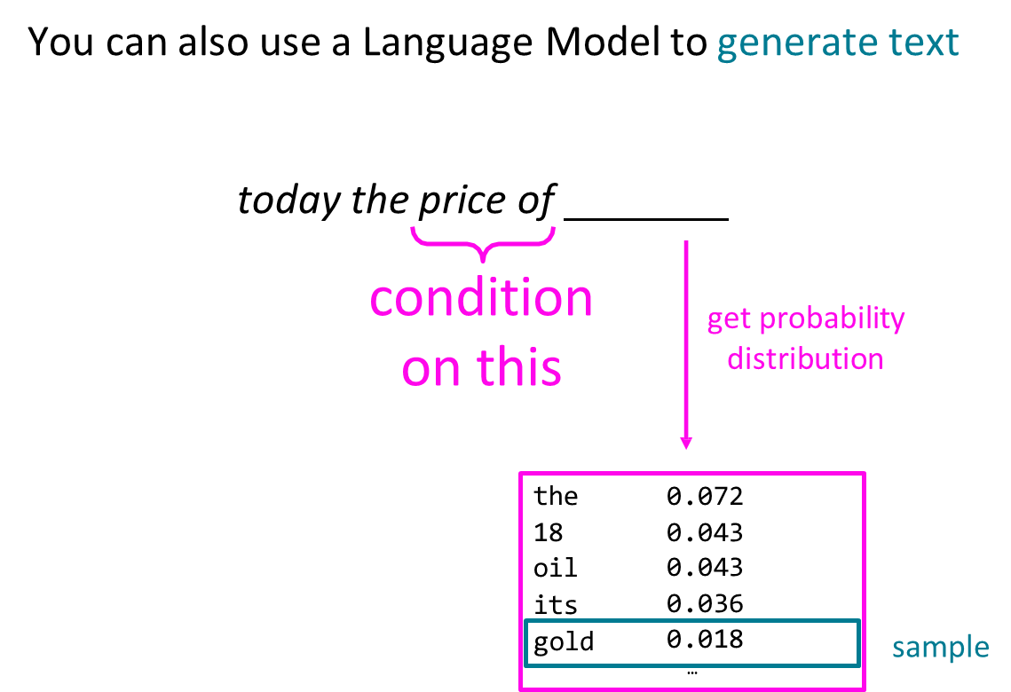
Generating text with a n-gram Language Model

Slide 13
Generating text with a n-gram Language Model
You can also use a Language Model to generate text:
today the price of gold per ton , while production of shoe lasts and shoe industry , the bank intervened just after it considered and rejected an imf demand to rebuild depleted european stocks , sept 30 end primary 76 cts a share .
Surprisingly grammatical!
…but incoherent. We need to consider more than three words at a time if we want to model language well.
But increasing n worsens sparsity problem, and increases model size…

Slide 14
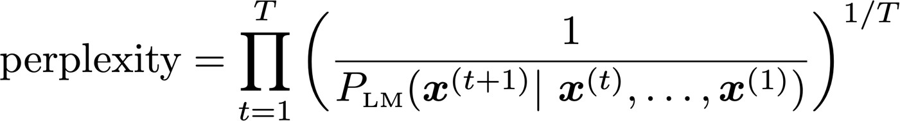
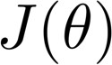
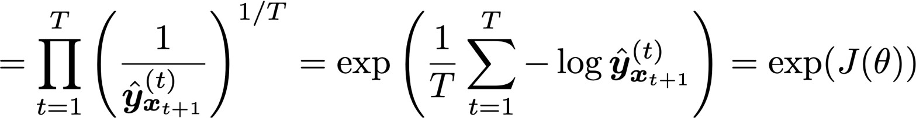
Evaluating Language Models
The standard evaluation metric for Language Models is perplexity.
(当惑度)
Normalized by
number of words
Inverse probability of corpus, according to Language Model
This is equal to the exponential of the cross-entropy loss
:
Lower perplexity is better!
Notes:
🔹 Conceptual Meaning
Perplexity is a numerical value indicating
“how ‘predictable’ (or ‘confused’) a language model is about the text.”
The smaller the value: The model accurately predicts the next word and is “not confused” = a smart model.
The larger the value: The model struggles to guess the next word and is “confused” = a low-performance model.
🔹 Meaning of the formula (interpreting the slide's equation in Japanese)
perplexity=(∏T PLM(x(t+1)∣x(t),…,x(1))1)1/T
PLM(x(t+1)∣x(t),…): Probability the language model predicted “the next word”
Its reciprocal 1/PLM: Degree to which the model finds predicting that word difficult (surprised)
Taking the geometric mean across the entire text (T words) represents the overall “confusion level”
🔹 Intuitive Image
perplexity = 1 → Model perfectly predicts the correct answer (ideal)
perplexity = 10 → Model has ambiguity equivalent to choosing “from about 10 possible candidates” on average
perplexity = 100 → Model is extremely confused
🔹 Conclusion
Perplexity is a metric indicating “how confidently the model predicts the next word without hesitation.”
A lower value indicates a better-trained language model.
The final slide's statement “Lower perplexity is better!” demonstrates this.
Symbol Meaning Relationship with cross-entropyxt​
The t-th word in the input sequence Input to the language modelx
t+1​The next word to be predicted True labely^​xt+1​(t)​The probability the model assigns to “xt+1​ being the next word” True class probability in the output distribution−logy^​xt+1​(t)​Loss of the log-likelihood of the correct word. One sample of the cross-entropy loss.J(θ) Average cross-entropy loss (Negative Log Likelihood). Perplexity transformed into log space.exp(J(θ)) Value of cross-entropy restored using an exponential function. Perplexity.

Slide 15
Simple NER: Window classification using binary logistic classifier
Idea: classify each word in its context window of neighboring words
Train logistic classifier on hand-labeled data to classify center word {yes/no} for each class based on a concatenation of word vectors in a window
Really, we usually use multi-class softmax, but we’re trying to keep it simple ☺
Example: Classify “Paris” as +/– location in context of sentence with window length 2:
the museums in Paris are amazing to see .
^{X}window ^{= [ x}museums ^{x}in ^{x}Paris ^{x}are ^{x}amazing ^{]T}
Resulting vector x_{window} =
To classify all words: run classifier for each class on the vector centered on each word in the sentence
x ∈ R^{5d}

Slide 16
Classification review and notation
Supervised learning: we have a training dataset consisting of samples
{x_{i},y_{i}}^{N}_{i=1}
x_{i} are inputs, e.g., words (indices or vectors!), sentences, documents, etc.
Dimension d
y_{i} are labels (one of C classes) we try to predict, for example:
classes: sentiment (+/–), named entities, buy/sell decision
other words
later: multi-word sequences

Slide 17
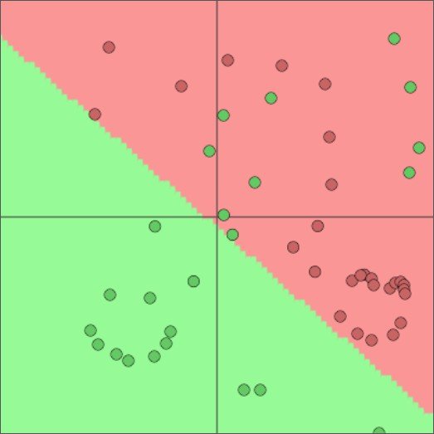
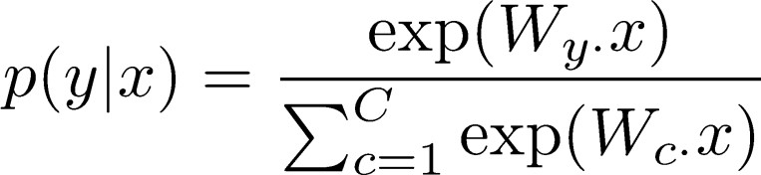
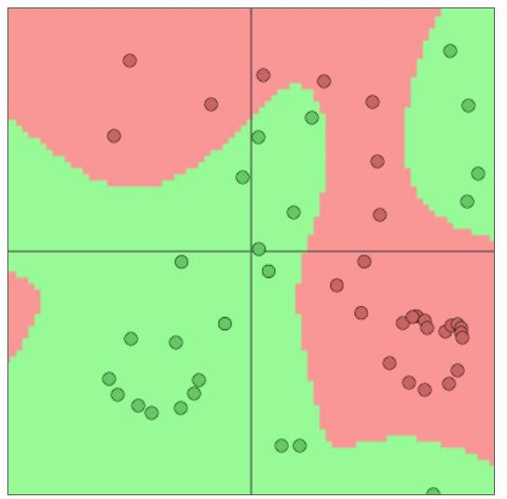
Neural classification
Typical ML/stats softmax classifier:
Learned parameters θ are just elements
of W (not input representation x, which has sparse symbolic features)
Classifier gives linear decision boundary, which can be limiting
A neural network classifier differs in that:
We learn both W and (distributed!) representations for words
The word vectors x re-represent one-hot vectors, moving them around in an intermediate layer vector space, for easy classification with a (linear) softmax classifier
Conceptually, we have an embedding layer: x = Le
We use deep networks—more layers—that let us re-represent and compose our data multiple times, giving a non-linear classifier
But typically, it is linear relative to the pre-final layer representation

Slide 18
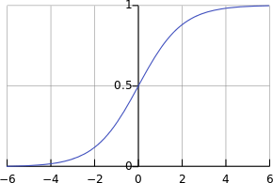
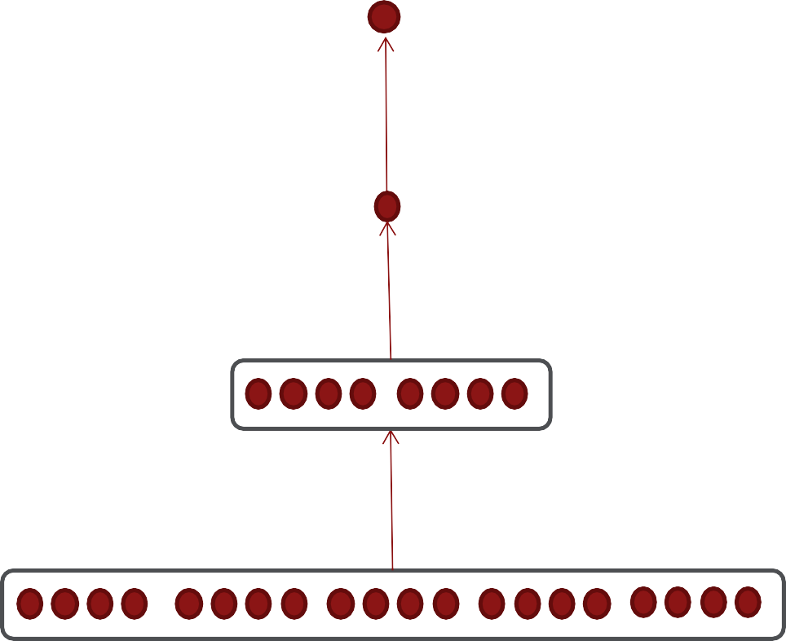
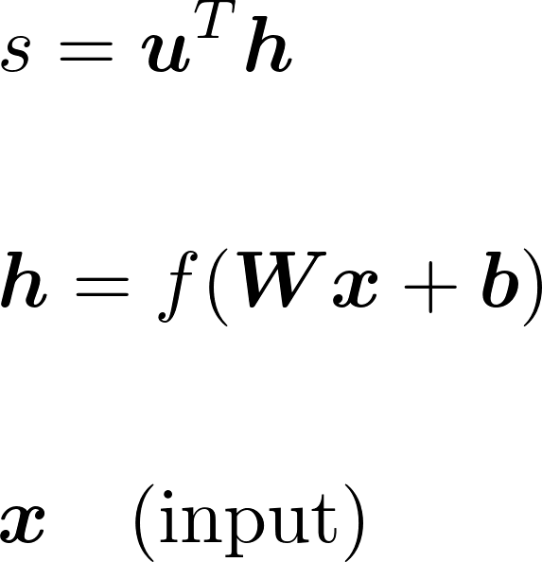
NER: Binary classification for center word being location
We do supervised training and want high score if it’s a location
predicted model probability of class
f = Some element- wise non-linear function, e.g., logistic, tanh, ReLU
_{∈ R}5d
^{x = [ x}museums
^{x}in ^{x}Paris
^{x}are
^{x}amazing ]
Embedding of 1-hot words

Slide 19
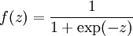
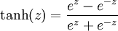
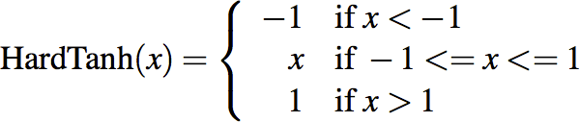
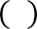
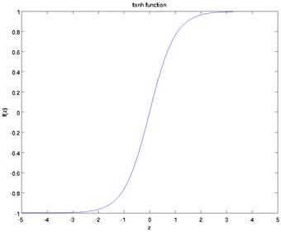
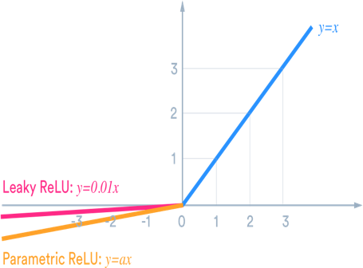
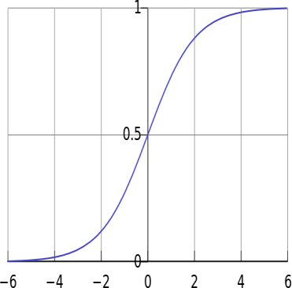
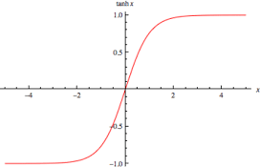

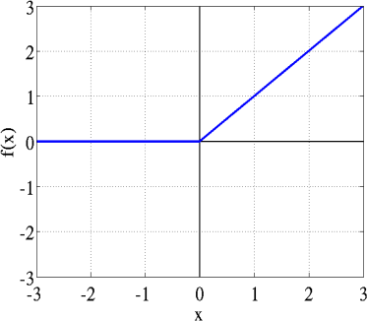
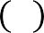
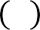
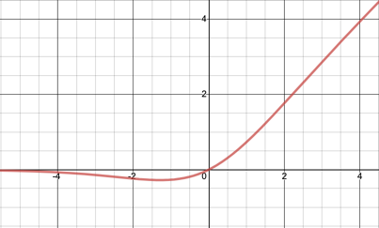
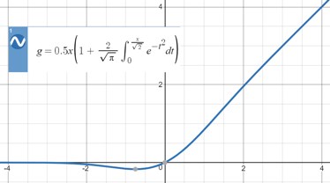
Non-linearities, old and new
(Rectified Linear Unit)
ReLU
ReLU 𝑧 = max(𝑧, 0)
Leaky ReLU / Parametric ReLU
logistic (“sigmoid”) tanh hard tanh
1
1
0
0
0
−1
tanh is just a rescaled and shifted sigmoid (2×as steep, [−1,1]):
tanh(z) = 2logistic(2z) −1
Logistic and tanh are still used (e.g., logistic to get a probability)
However, now, for deep networks, the first thing to try is ReLU: it trains quickly and performs well due to good gradient backflow.
ReLU has a negative “dead zone” that recent proposals mitigate
GELU is frequently used with Transformers (BERT, RoBERTa, etc.)
Swish arXiv:1710.05941
swish 𝑥 = 𝑥 ∙ logistic(𝑥)
GELU arXiv:1606.08415
GELU 𝑥
= 𝑥 ∙ 𝑃 𝑋 ≤ 𝑥 , 𝑋~𝑁(0,1)
≈ 𝑥 ∙ logistic(1.702𝑥)
0

Slide 20
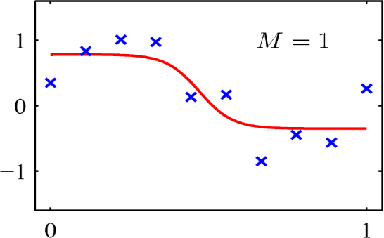
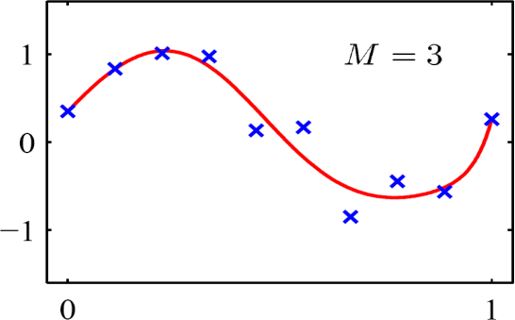
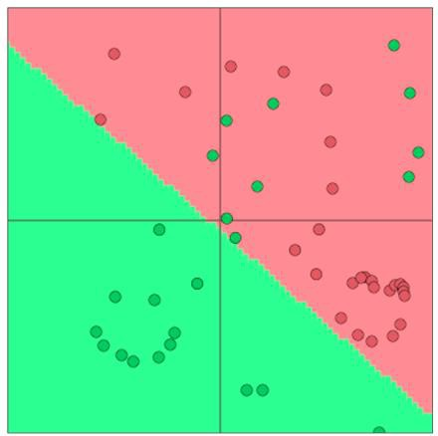
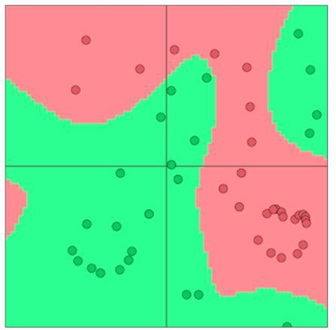
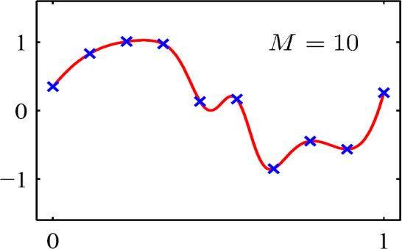
Non-linearities (i.e., “f ” on previous slide): Why they’re needed
Neural networks do function approximation, e.g., regression or classification
Without non-linearities, deep neural networks
can’t do anything more than a linear transform
Extra layers could just be compiled down into a single linear transform: W₁ W₂ x = Wx
But, with more layers that include non-linearities, they can approximate any complex function!

Slide 21
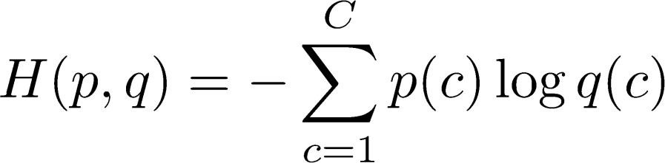
Training with “cross entropy loss” – you use this in PyTorch!
Until now, our objective was stated as to maximize the probability of the correct class y
or equivalently we can minimize the negative log probability of that class
Now restated in terms of cross entropy, a concept from information theory
Let the true probability distribution be p; let our computed model probability be q
The cross entropy is:
Assuming a ground truth (or true or gold or target) probability distribution that is 1 at the right class and 0 everywhere else, p = [0, …, 0, 1, 0, …, 0], then:
Because of one-hot p, the only term left is the negative log probability of the true
class y_{i}: − log 𝑝(𝑦_{𝑖}|𝑥_{𝑖})
Cross entropy can be used in other ways with a more interesting p,
but for now just know that you’ll want to use it as the loss in PyTorch

Slide 22
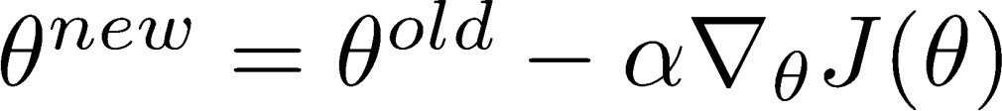
Remember: Stochastic Gradient Descent
Update equation:
𝛼 = step size or learning rate
i.e., for each parameter: 𝜃^{𝑛𝑒𝑤} = 𝜃^{𝑜𝑙𝑑} − 𝛼 ^{𝜕𝐽 𝜃}
𝑗 𝑗 _{𝜕𝜃}𝑜𝑙𝑑
𝑗
In deep learning, 𝜃 includes the data representation (e.g., word vectors) too!
How can we compute ∇_{𝜃}𝐽(𝜃)?
By hand
Algorithmically: the backpropagation algorithm

Slide 23
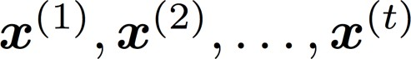
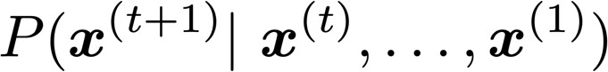

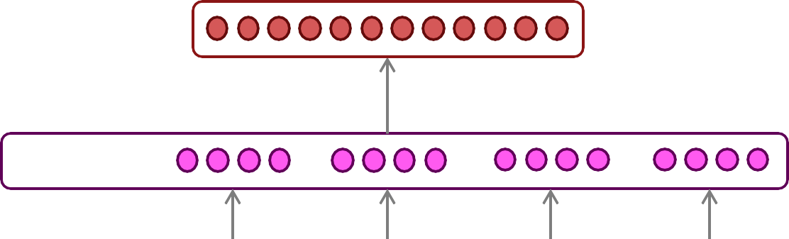



How to build a neural language model?
Recall the Language Modeling task:
Input: sequence of words
Output: prob. dist. of the next word
LOCATION
museums
in
Paris
are amazing

Slide 24
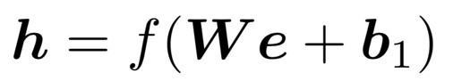



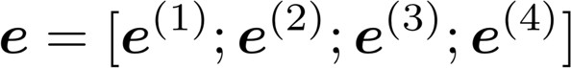



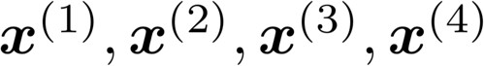
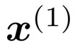
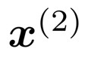
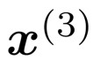

A fixed-window neural Language Model
books
laptops
output distribution
a
zoo
hidden layer
concatenated word embeddings
words / one-hot vectors
the students
opened
their

Slide 25






A fixed-window neural Language Model
Approximately: Y. Bengio, et al. (2000/2003): A Neural Probabilistic Language Model
books
Improvements over n-gram LM:
No sparsity problem
laptops
Don’t need to store all observed n-grams
a
zoo
Remaining problems:
Fixed window is too small
Enlarging window enlarges 𝑊
Window can never be large enough!
𝑥⁽¹⁾ and 𝑥⁽²⁾ are multiplied by completely different weights in 𝑊. No symmetry in how the inputs are processed.
We need a neural architecture that can process any length input
the students
opened
their

Slide 26























2. Recurrent Neural Networks (RNN)
A family of neural architectures
Core idea: Apply the same weights 𝑊 repeatedly
outputs (optional)
…
hidden states
…
input sequence (any length)
…

Slide 27

























A Simple RNN Language Model
books
laptops
output distribution
a
zoo
hidden states
is the initial hidden state
word embeddings
words / one-hot vectors
the students
opened
their
Note: this input sequence could be much
longer now!
27

Slide 28

RNN Language Models
books
laptops
RNN Advantages:
Can process any length input
Computation for step t can (in theory) use information from
many steps back
Model size doesn’t increase for longer input context
Same weights applied on every
timestep, so there is symmetry in how inputs are processed.
a
zoo
RNN Disadvantages:
Recurrent computation is slow
In practice, difficult to access information from many steps
back
More on these later
the students
opened
their

Slide 29






Training an RNN Language Model
Get a big corpus of text which is a sequence of words
Feed into RNN-LM; compute output distribution for every step t.
i.e., predict probability dist of every word, given words so far
Loss function on step t is cross-entropy between predicted probability distribution , and the true next word (one-hot for ):
Average this to get overall loss for entire training set:

Slide 30










Training an RNN Language Model
= negative log prob
of “students”
Loss
Predicted prob dists
…
Corpus
the
students
opened
their
exams
…

Slide 31

Training an RNN Language Model
= negative log prob
of “opened”
Loss
Predicted prob dists
…
Corpus
the
students
opened
their
exams
…

Slide 32
Training an RNN Language Model
= negative log prob
of “their”
Loss
Predicted prob dists
…
Corpus
the
students
opened
their
exams
…

Slide 33
Training an RNN Language Model
= negative log prob
of “exams”
Loss
Predicted prob dists
…
Corpus
the
students
opened
their
exams
…

Slide 34

Training an RNN Language Model
“Teacher forcing”
Loss
+
+
+
+ … =
Predicted prob dists
…
Corpus
the
students
opened
their
exams
…

Slide 35



Training a RNN Language Model
However: Computing loss and gradients across entire corpus too expensive (memory-wise)!
at once is
In practice, consider as a sentence (or a document)
Recall: Stochastic Gradient Descent allows us to compute loss and gradients for small chunk of data, and update.
Compute loss for a sentence (actually, a batch of sentences), compute gradients and update weights. Repeat on a new batch of sentences.

Slide 36








Backpropagation for RNNs
…
…
Question: What’s the derivative of
w.r.t. the repeated weight matrix
?
“The gradient w.r.t. a repeated weight is the sum of the gradient
w.r.t. each time it appears”
Answer:
Why?

Slide 37



Multivariable Chain Rule
Source:
https://www.khanacademy.org/math/multivariable-calculus/multivariable-derivatives/differentiating-vector-valued-functions/a/multivariable-chain-rule-simple-version

Slide 38






Training the parameters of RNNs: Backpropagation for RNNs
In practice, often
“truncated” after ~20 timesteps for training efficiency reasons
…
…
Apply the multivariable chain rule:
= 1
Question: How do we calculate this?
Answer: Backpropagate over timesteps
i = t, … ,0, summing gradients as you go. This algorithm is called “backpropagation through time” [Werbos, P.G., 1988, Neural Networks 1, and others]
38

Slide 39









Generating with an RNN Language Model (“Generating roll outs”)
Just like an n-gram Language Model, you can use a RNN Language Model to
generate text by repeated sampling. Sampled output becomes next step’s input.
my
sample
favorite
sample
season
sample
is
sample
spring
sample
</s>
sample
39
<s>
my
favorite
season
is
spring

Slide 40


Generating text with an RNN Language Model
Let’s have some fun!
You can train an RNN-LM on any kind of text, then generate text in that style.
RNN-LM trained on Harry Potter:
Source: https://medium.com/deep-writing/harry-potter-written-by-artificial-intelligence-8a9431803da6
41

Slide 41







3. Problems with RNNs: Vanishing and Exploding Gradients

Slide 42

Vanishing gradient intuition
?

Slide 43


Vanishing gradient intuition
chain rule!

Slide 44


Vanishing gradient intuition
chain rule!

Slide 45


Vanishing gradient intuition
chain rule!

Slide 46
Vanishing gradient intuition
Vanishing gradient problem: When these are small, the gradient signal gets smaller and smaller as it backpropagates further
What happens if these are small?

Slide 47

















Vanishing gradient proof sketch (linear case)
Recall:
What if
were the identity function,
?
(chain rule)
Consider the gradient of the loss
on step , with respect
to the hidden state on some previous step . Let
(chain rule)
(value of
)
If W_{h} is “small”, then this term gets
exponentially problematic as becomes large
Source: “On the difficulty of training recurrent neural networks”, Pascanu et al, 2013. http://proceedings.mlr.press/v28/pascanu13.pdf
(and supplemental materials), at http://proceedings.mlr.press/v28/pascanu13-supp.pdf
50

Slide 48









Vanishing gradient proof sketch (linear case)
sufficient but
What’s wrong with ?
Consider if the eigenvalues of are all less than 1:
not necessary
(eigenvectors) using the eigenvectors of
We can write
as a basis:
Approaches 0 as
grows, so gradient vanishes
What about nonlinear activations (i.e., what we use?)
Pretty much the same thing, except the proof requires
for some dependent on dimensionality and
51
Source: “On the difficulty of training recurrent neural networks”, Pascanu et al, 2013. http://proceedings.mlr.press/v28/pascanu13.pdf
(and supplemental materials), at http://proceedings.mlr.press/v28/pascanu13-supp.pdf

Slide 49

Why is vanishing gradient a problem?
Gradient signal from far away is lost because it’s much smaller than gradient signal from close-by.
So, model weights are updated only with respect to near effects, not long-term effects.

Slide 50
Effect of vanishing gradient on RNN-LM
LM task: When she tried to print her tickets, she found that the printer was out of toner. She went to the stationery store to buy more toner. It was very overpriced. After installing the toner into the printer, she finally printed her
To learn from this training example, the RNN-LM needs to model the dependency between “tickets” on the 7th step and the target word “tickets” at the end.
But if the gradient is small, the model can’t learn this dependency
So, the model is unable to predict similar long-distance dependencies at test time

Slide 51

Why is exploding gradient a problem?
If the gradient becomes too big, then the SGD update step becomes too big:
learning rate
gradient
This can cause bad updates: we take too large a step and reach a weird and bad parameter configuration (with large loss)
You think you’ve found a hill to climb, but suddenly you’re in Iowa
In the worst case, this will result in Inf or NaN in your network (then you have to restart training from an earlier checkpoint)

Slide 52

Gradient clipping: solution for exploding gradient
Gradient clipping: if the norm of the gradient is greater than some threshold, scale it down before applying SGD update
Intuition: take a step in the same direction, but a smaller step
In practice, remembering to clip gradients is important, but exploding gradients are an
easy problem to solve
55
Source: “On the difficulty of training recurrent neural networks”, Pascanu et al, 2013. http://proceedings.mlr.press/v28/pascanu13.pdf

Slide 53

How to fix the vanishing gradient problem?
The main problem is that it’s too difficult for the RNN to learn to preserve information
over many timesteps.
In a vanilla RNN, the hidden state is constantly being rewritten
First off next time: How about an RNN with separate memory which is added to?
LSTMs
And then: Creating more direct and linear pass-through connections in model
Attention, residual connections, etc.

Slide 54

Long Short-Term Memory RNNs (LSTMs)
A type of RNN proposed by Hochreiter and Schmidhuber in 1997 as a solution to the problem of vanishing gradients
Everyone cites that paper but really a crucial part of the modern LSTM is from Gers et al. (2000)
Only started to be recognized as promising through the work of S’s student Alex Graves c. 2006
Work in which he also invented CTC (connectionist temporal classification) for speech recognition
But only really became well-known after Hinton brought it to Google in 2013
Following Graves having been a postdoc with Hinton
Hochreiter and Schmidhuber, 1997. Long short-term memory. https://www.bioinf.jku.at/publications/older/2604.pdf Gers, Schmidhuber, and Cummins, 2000. Learning to Forget: Continual Prediction with LSTM. https://dl.acm.org/doi/10.1162/089976600300015015
Graves, Fernandez, Gomez, and Schmidhuber, 2006. Connectionist temporal classification: Labelling unsegmented sequence data with recurrent neural nets.
https://www.cs.toronto.edu/~graves/icml_2006.pdf

Slide 55
Long Short-Term Memory RNNs (LSTMs)
On step t, there is a hidden state 𝒉^{(𝑡)} and a cell state 𝒄^{(𝑡)}
Both are vectors length n
The cell stores long-term information
The LSTM can read, erase, and write information from the cell
The cell becomes conceptually rather like RAM in a computer
The selection of which information is erased/written/read is controlled by three corresponding gates
The gates are also vectors of length n
On each timestep, each element of the gates can be open (1), closed (0), or somewhere in-between
The gates are dynamic: their value is computed based on the current context

Slide 56


Long Short-Term Memory (LSTM)
We have a sequence of inputs 𝑥^{(𝑡)}, and we will compute a sequence of hidden states ℎ^{(𝑡)} and cell states
𝑐^{(𝑡)}. On timestep t:
Sigmoid function: all gate values are between 0 and 1
Forget gate: controls what is kept vs forgotten, from previous cell state
Input gate: controls what parts of the new cell content are written to cell
All these are vectors of same length n
Output gate: controls what parts of
cell are output to hidden state
New cell content: this is the new content to be written to the cell
Cell state: erase (“forget”) some content from last cell state, and write (“input”) some new cell content
Hidden state: read (“output”) some
content from the cell
Gates are applied using element-wise (or Hadamard) product: ⊙
7

Slide 57


Long Short-Term Memory (LSTM)
You can think of the LSTM equations visually like this:
Source: http://colah.github.io/posts/2015-08-Understanding-LSTMs/

Slide 58

Long Short-Term Memory (LSTM)
You can think of the LSTM equations visually like this:
Write some new cell content
The + sign is the secret!
Forget some
cell content
c_{t}
c_{t}
^{c}t-1
f
i_{t}
o_{t}
Output some cell content to the hidden state
Compute the
forget gate
t
_{c}~
t
^{h}t-1
h_{t}
Compute the input gate
Compute the new cell content
Compute the output gate
Source: http://colah.github.io/posts/2015-08-Understanding-LSTMs/

Slide 59
How does LSTM solve vanishing gradients?
The LSTM architecture makes it much easier for an RNN to preserve information over many timesteps
e.g., if the forget gate is set to 1 for a cell dimension and the input gate set to 0, then the information of that cell is preserved indefinitely.
In contrast, it’s harder for a vanilla RNN to learn a recurrent weight
matrix W_{h} that preserves info in the hidden state
In practice, you get about 100 timesteps rather than about 7
However, there are alternative ways of creating more direct and linear pass-through connections in models for long distance dependencies

Slide 60

Is vanishing/exploding gradient just an RNN problem?
No! It can be a problem for all neural architectures (including feed-forward and convolutional), especially very deep ones.
Due to chain rule / choice of nonlinearity function, gradient can become vanishingly small as it backpropagates
Thus, lower layers are learned very slowly (i.e., are hard to train)
Another solution: lots of new deep feedforward/convolutional architectures add more direct connections (thus allowing the gradient to flow)
For example:
Residual connections aka “ResNet”
Also known as skip-connections
The identity connection preserves information by default
This makes deep networks much easier to train
"Deep Residual Learning for Image Recognition", He et al, 2015. https://arxiv.org/pdf/1512.03385.pdf

Slide 61


Is vanishing/exploding gradient just a RNN problem?
Other methods:
Dense connections aka “DenseNet”
Directly connect each layer to all future layers!
Highway connections aka “HighwayNet”
Similar to residual connections, but the identity connection vs the transformation layer is controlled by a dynamic gate
Inspired by LSTMs, but applied to deep
feedforward/convolutional networks
Conclusion: Though vanishing/exploding gradients are a general problem, RNNs are particularly unstable due to the repeated multiplication by the same weight matrix [Bengio et al, 1994]
”Densely Connected Convolutional Networks", Huang et al, 2017. https://arxiv.org/pdf/1608.06993.pdf ”Highway Networks", Srivastava et al, 2015. https://arxiv.org/pdf/1505.00387.pdf
”Learning Long-Term Dependencies with Gradient Descent is Difficult", Bengio et al. 1994, http://ai.dinfo.unifi.it/paolo//ps/tnn-94-gradient.pdf
12

Slide 62
LSTMs: real-world success
In 2013–2015, LSTMs started achieving state-of-the-art results
Successful tasks include handwriting recognition, speech recognition, machine translation, parsing, and image captioning, as well as language models
LSTMs became the dominant approach for most NLP tasks
Recently (2019–2024), Transformers have become dominant for all tasks
For example, in WMT (a Machine Translation conference + competition):
In WMT 2014, there were 0 neural machine translation systems (!)
In WMT 2016, the summary report contains “RNN” 44 times (and these systems won)
In WMT 2019: “RNN” 7 times, ”Transformer” 105 times
Now, ‘State space models’ (RNN++) are making a comeback
Source: "Findings of the 2016 Conference on Machine Translation (WMT16)", Bojar et al. 2016, http://www.statmt.org/wmt16/pdf/W16-2301.pdf Source: "Findings of the 2018 Conference on Machine Translation (WMT18)", Bojar et al. 2018, http://www.statmt.org/wmt18/pdf/WMT028.pdf Source: "Findings of the 2019 Conference on Machine Translation (WMT19)", Barrault et al. 2019, http://www.statmt.org/wmt18/pdf/WMT028.pdf

Slide 63







4. Bidirectional and Multi-layer RNNs: motivation
Task: Sentiment Classification
We can regard this hidden state as a representation of the word “terribly” in the context of this sentence. We call this a contextual representation.
positive
Sentence encoding
These contextual representations only contain information about the left context (e.g. “the movie was”).
What about right
context?
In this example, “exciting” is in the right context and this modifies the meaning of “terribly” (from negative to positive)
the
movie
was
terribly
exciting
!

Slide 64

Bidirectional RNNs
This contextual representation of “terribly”
has both left and right context!
Concatenated hidden states
Backward RNN
Forward RNN
the
movie
was
terribly
exciting
!

Slide 65

Bidirectional RNNs
This is a general notation to mean “compute one forward step of the RNN” – it could be a simple RNN or LSTM computation.
On timestep t:
Forward RNN
Generally, these two RNNs have separate weights
Backward RNN
Concatenated hidden states
We regard this as “the hidden state” of a bidirectional RNN. This is what we pass on to the next parts of the network.
16

Slide 66

Bidirectional RNNs: simplified diagram
the
movie
was
terribly
exciting
!
The two-way arrows indicate bidirectionality and the depicted hidden states are assumed to be the concatenated forwards+backwards states

Slide 67
Bidirectional RNNs
Note: bidirectional RNNs are only applicable if you have access to the entire input sequence
They are not applicable to Language Modeling, because in LM you only have left context available.
If you do have entire input sequence (e.g., any kind of encoding), bidirectionality is
powerful (you should use it by default).
For example, BERT (Bidirectional Encoder Representations from Transformers) is a powerful pretrained contextual representation system built on bidirectionality.
You will learn more about transformers, including BERT, in a couple of weeks!

Slide 68






Multi-layer RNNs
RNNs are already “deep” on one dimension (they unroll over many timesteps)
We can also make them “deep” in another dimension by
applying multiple RNNs – this is a multi-layer RNN.
This allows the network to compute more complex representations
The lower RNNs should compute lower-level features and the higher RNNs should compute higher-level features.
Multi-layer RNNs are also called stacked RNNs.

Slide 69

Multi-layer RNNs
The hidden states from RNN layer i
are the inputs to RNN layer i+1
RNN layer 3
RNN layer 2
RNN layer 1
the
movie
was
terribly
exciting
!

Slide 70
Multi-layer RNNs in practice
Multi-layer or stacked RNNs allow a network to compute more complex representations
they work better than just have one layer of high-dimensional encodings!
The lower RNNs should compute lower-level features and the higher RNNs should compute higher-level features.
High-performing RNNs are usually multi-layer (but aren’t as deep as convolutional or
feed-forward networks)
For example: In a 2017 paper, Britz et al. find that for Neural Machine Translation, 2 to 4 layers is best for the encoder RNN, and 4 layers is best for the decoder RNN
Often 2 layers is a lot better than 1, and 3 might be a little better than 2
Usually, skip-connections/dense-connections are needed to train deeper RNNs (e.g., 8 layers)
Transformer-based networks (e.g., BERT) are usually deeper, like 12 or 24 layers.
You will learn about Transformers later; they have a lot of skipping-like connections
“Massive Exploration of Neural Machine Translation Architecutres”, Britz et al, 2017. https://arxiv.org/pdf/1703.03906.pdf
21

Slide 71
Machine Translation
Machine Translation (MT) is the task of translating a sentence x from one language (the source language) to a sentence y in another language (the target language).
x:
L'homme est né libre, et partout il est dans les fers
y:
Man is born free, but everywhere he is in chains
– Rousseau
22

Slide 72
The early history of MT: 1950s
Machine translation research began in the early 1950s on machines less
powerful than high school calculators (before term “A.I.” coined!)
Concurrent with foundational work on automata, formal languages, probabilities, and information theory
MT heavily funded by military, but basically just simple rule-based systems doing word substitution
Human language is more complicated than that, and varies more across languages!
Little understanding of natural language syntax, semantics, pragmatics
Problem soon appeared intractable
1 minute video showing 1954 MT: https://youtu.be/K-HfpsHPmvw

Slide 73

The early history of MT: 1950s

Slide 74


1990s-2010s: Statistical Machine Translation
Core idea: Learn a probabilistic model from data
Suppose we’re translating French → English.
We want to find best English sentence y, given French sentence x
Use Bayes Rule to break this down into two components to be learned separately:
Translation Model
Models how words and phrases should be translated (fidelity).
Learned from parallel data.
Language Model
Models how to write good English (fluency).
Learned from monolingual data.
25

Slide 75
1990s–2010s: Statistical Machine Translation
SMT was a huge research field
The best systems were extremely complex
Hundreds of important details
Systems had many separately-designed subcomponents
Lots of feature engineering
Need to design features to capture particular language phenomena
Required compiling and maintaining extra resources
Like tables of equivalent phrases
Lots of human effort to maintain
Repeated effort for each language pair!
26

Slide 76



2014
(dramatic reenactment)

Slide 77








NMT: the first big success story of NLP Deep Learning
Neural Machine Translation went from a fringe research attempt in 2014 to the leading standard method in 2016
2014: First seq2seq paper published [Sutskever et al. 2014]
2016: Google Translate switches from SMT to NMT – and by 2018 everyone has
This is amazing!
SMT systems, built by hundreds of engineers over many years, outperformed by NMT systems trained by small groups of engineers in a few months
28

Slide 78


Neural Machine Translation (NMT)
The sequence-to-sequence model
Target sentence (output)
Encoding of the source sentence.
Provides initial hidden state for Decoder RNN.
he hit me with a pie <END>
argmax
argmax
argmax
argmax
argmax
argmax
argmax
Encoder RNN
Decoder RNN
il
m’
a entarté
<START> he hit me with a pie
Source sentence (input)
Decoder RNN is a Language Model that generates target sentence, conditioned on encoding.
Encoder RNN produces an encoding of the source sentence.
Note: This diagram shows test time behavior: decoder
output is fed in as next step’s input
29

Slide 79
Sequence-to-sequence is versatile!
The general notion here is an encoder-decoder model
One neural network takes input and produces a neural representation
Another network produces output based on that neural representation
If the input and output are sequences, we call it a seq2seq model
Sequence-to-sequence is useful for more than just MT
Many NLP tasks can be phrased as sequence-to-sequence:
Summarization (long text → short text)
Dialogue (previous utterances → next utterance)
Parsing (input text → output parse as sequence)
Code generation (natural language → Python code)

Slide 80

Neural Machine Translation (NMT)
The sequence-to-sequence model is an example of a Conditional Language Model
Language Model because the decoder is predicting the next word of the target sentence y
Conditional because its predictions are also conditioned on the source sentence x
NMT directly calculates
:
Probability of next target word, given target words so far and source sentence x
Question: How to train an NMT system?
(Easy) Answer: Get a big parallel corpus…
But there is now exciting work on “unsupervised NMT”, data augmentation, etc.

Slide 81


Training a Neural Machine Translation system
= negative log
prob of “he”
= negative log
prob of “with”
= negative log
prob of <END>
1
𝑇
𝐽 = ෍ 𝐽_{𝑡}
𝑇
𝑡=1
=
𝐽₁
+
𝐽₂
+
𝐽₃
+
𝐽₄
+
𝐽₅
+
𝐽₆
+
𝐽₇
𝑦ො₁
𝑦ො₂
𝑦ො₃
𝑦ො₄
𝑦ො₅
𝑦ො₆
𝑦ො₇
Encoder RNN
Decoder RNN
il m’ a entarté
Source sentence (from corpus)
<START> he hit me with
Target sentence (from corpus)
a
pie
Seq2seq is optimized as a single system. Backpropagation operates “end-to-end”.
32

Slide 82



Multi-layer deep encoder-decoder machine translation net
[Sutskever et al. 2014; Luong et al. 2015]
The hidden states from RNN layer i
are the inputs to RNN layer i+1
Translation generated
The protests escalated
over
the weekend
<EOS>
 | 0.1 | 0.2 | 0.4 | 0.5 | 0.2 | -0.1 | 0.2 | 0.2 | 0.3 | 0.4 | -0.2 | -0.4 | -0.3
 | 0.3 | 0.6 | 0.4 | 0.5 | 0.6 | 0.6 | 0.6 | 0.6 | 0.6 | 0.4 | 0.6 | 0.6 | 0.5
 | 0.1 | -0.1 | 0.3 | 0.9 | -0.1 | -0.1 | -0.1 | -0.1 | -0.1 | -0.1 | -0.1 | -0.1 | -0.1
 | -0.4 | -0.7 | -0.2 | -0.3 | -0.5 | -0.7 | -0.7 | -0.7 | -0.7 | -0.7 | -0.7 | -0.7 | -0.7
 | 0.2 | 0.1 | -0.3 | -0.2 | 0.1 | 0.1 | 0.1 | 0.1 | 0.1 | 0.1 | 0.1 | 0.1 | 0.1
Encoder:
0.2 |  | 0.2 | 0.1 | 0.2 | 0.2 | 0.2 | 0.2 | -0.4 | 0.2 | -0.1 | 0.2 | 0.3 | 0.2
 |  | 0.6 | 0.3 | 0.6 | -0.8 | 0.6 | -0.1 | 0.6 | 0.6 | 0.6 | 0.4 | 0.6 | 0.6
-0.1 |  | -0.1 | -0.1 | -0.1 | -0.1 | -0.1 | -0.1 | -0.1 | -0.1 | -0.1 | -0.1 | -0.1 | -0.1
sentence | 0.1 0.1 | -0.7 0.1 | -0.7 0.1 | -0.4 0.1 | -0.5 0.1 | -0.7 0.1 | -0.7 0.1 | -0.7 0.1 | 0.3 0.1 | 0.3 0.1 | 0.2 0.1 | -0.5 0.1 | -0.7 0.1
meaning
 | 0.2 | 0.4 | 0.2 | 0.2 | 0.4 | 0.2 | 0.2 | 0.2 | 0.2 | -0.1 | -0.2 | -0.4 | 0.2
 | 0.6 | -0.6 | -0.3 | 0.4 | -0.2 | 0.6 | 0.6 | 0.6 | 0.6 | 0.3 | 0.6 | 0.5 | 0.6
 | -0.1 | 0.2 | -0.1 | 0.1 | -0.3 | -0.1 | -0.1 | -0.1 | -0.1 | -0.1 | 0.1 | -0.5 | -0.1
 | -0.7 | -0.3 | -0.4 | -0.5 | -0.4 | -0.7 | -0.7 | -0.7 | -0.7 | -0.7 | 0.3 | 0.4 | -0.7
 | 0.1 | 0.4 | 0.2 | -0.2 | -0.2 | 0.1 | 0.1 | 0.1 | 0.1 | 0.1 | 0.1 | 0.1 | 0.1
Builds up
-0.2
Decoder
Source
sentence
Die Proteste waren am Wochenende eskaliert <EOS>
The protests escalated over
the weekend
Feeding in
last word
Conditioning = Bottleneck
33

Slide 83

The final piece: the bottleneck problem in RNNs
Encoding of the source sentence.
Target sentence (output)
he
hit
me with
a
pie <END>
Encoder RNN
Decoder RNN
il
a
m’ entarté
<START> he
hit
me with
a
pie
Source sentence (input)
Problems with this architecture?

Slide 84
Issues with recurrent models: Linear interaction distance
O(sequence length) steps for distant word pairs to interact means:
Hard to learn long-distance dependencies (because gradient problems!)
Linear order of words is “baked in”; we already know linear order isn’t the right way to think about sentences…
The chef who …
was
Info of chef has gone through O(sequence length) many layers!

Slide 85
Issues with recurrent models: Lack of parallelizability
Forward and backward passes have O(sequence length)
unparallelizable operations
GPUs can perform a bunch of independent computations at once!
But future RNN hidden states can’t be computed in full before past RNN
hidden states have been computed
Inhibits training on very large datasets!
1
2
3
n
0
1
2
h₁ h₂
h_{T}
Numbers indicate min # of steps before a state can be computed

Slide 86

Attention
Attention provides a solution to the bottleneck problem.
Core idea: on each step of the decoder, use direct connection to the encoder to focus on a particular part of the source sequence
First, we will show via diagram (no equations), then we will show with equations

Slide 87

The starting point: mean-pooling for RNNs
positive
How to compute sentence encoding?
Usually better: Take element-wise max or mean of all hidden states
Sentence encoding
overall I enjoyed the movie a lot
Starting point: a very basic way of ‘passing information from the encoder’ is to average

Slide 88


Attention is weighted averaging, which lets you do lookups!
Attention is just a weighted average – this is very powerful if the weights are learned!
In attention, the query matches all keys softly, to a weight between 0 and 1. The keys’ values are multiplied by the weights and summed.
In a lookup table, we have a table of keys that map to values. The query matches one of the keys, returning its value.

Slide 89

Sequence-to-sequence with attention
Core idea: on each step of the decoder, use direct connection to the encoder to focus on a particular part of the source sequence
dot product
Attention
scores
Decoder RNN
Encoder
RNN
il
a
m’ entarté
<START>
Source sentence (input)

Slide 90

Sequence-to-sequence with attention
dot product
Attention
scores
Decoder RNN
Encoder
RNN
il
a
m’ entarté
<START>
Source sentence (input)

Slide 91

Sequence-to-sequence with attention
dot product
Attention
scores
Decoder RNN
Encoder
RNN
il
a
m’ entarté
<START>
Source sentence (input)

Slide 92

Sequence-to-sequence with attention
dot product
Attention
scores
Decoder RNN
Encoder
RNN
il
a
m’ entarté
<START>
Source sentence (input)

Slide 93
Sequence-to-sequence with attention
On this decoder timestep, we’re mostly focusing on the first encoder hidden state (”he”)
Attention
distribution
Take softmax to turn the scores into a probability distribution
Attention
scores
Decoder RNN
Encoder
RNN
il
a
m’ entarté
<START>
Source sentence (input)

Slide 94

Sequence-to-sequence with attention
Attention output
Use the attention distribution to take a
weighted sum of the encoder hidden states.
The attention output mostly contains information from the hidden states that received high attention.
Attention
distribution
Attention
scores
Decoder RNN
Encoder
RNN
il
a
m’ entarté
<START>
Source sentence (input)

Slide 95
Sequence-to-sequence with attention
Attention output
he
Concatenate attention output with decoder hidden state, then use to compute 𝑦ො₁ as before
Attention
distribution
𝑦ො₁
Attention
scores
Decoder RNN
Encoder
RNN
il
a
m’ entarté
<START>
Source sentence (input)

Slide 96


Sequence-to-sequence with attention
Attention output
hit
Attention
distribution
𝑦ො₂
Attention
scores
Decoder RNN
Encoder
RNN
Sometimes we take the attention output from the previous step, and also feed it into the decoder (along with the usual decoder input). We do this in Assignment 4.
il
a
m’ entarté
<START> he
Source sentence (input)

Slide 97


Sequence-to-sequence with attention
Attention output
me
Attention
distribution
𝑦ො₃
Attention
scores
Decoder RNN
Encoder
RNN
il
a
m’ entarté
<START> he
hit
Source sentence (input)

Slide 98

Sequence-to-sequence with attention
Attention output
with
Attention
distribution
𝑦ො₄
Attention
scores
Decoder RNN
Encoder
RNN
il
a
m’ entarté
<START> he
hit
me
Source sentence (input)

Slide 99
Sequence-to-sequence with attention
Attention output
a
Attention
distribution
𝑦ො₅
Attention
scores
Decoder RNN
Encoder
RNN
il
a
m’ entarté
<START> he
hit
me with
Source sentence (input)

Slide 100

Sequence-to-sequence with attention
Attention output
pie
Attention
distribution
𝑦ො₆
Attention
scores
Decoder RNN
Encoder
RNN
il
a
m’ entarté
<START> he
hit
me with
a
Source sentence (input)

Slide 101









Attention: in equations
We have encoder hidden states
On timestep t, we have decoder hidden state
We get the attention scores for this step:
We take softmax to get the attention distribution sums to 1)
for this step (this is a probability distribution and
We use
to take a weighted sum of the encoder hidden states to get the attention output
Finally we concatenate the attention output with the decoder hidden state and proceed as in the non-attention seq2seq model

Slide 102
Attention is parallelizable, and solves bottleneck issues.
Attention treats each word’s representation as a query to access and incorporate information from a set of values.
We saw attention from the decoder to the encoder; today we’ll think about
attention within a single sentence.
Number of unparallelizable operations does not increase with sequence length.
Maximum interaction distance: O(1), since all words interact at every layer!
All words attend to all words in
previous layer; most arrows here
are omitted
attention
2 2
2
2
2
2
2 2
attention embedding
1 1
1
1
1
1
1
1
0 0 0 0 0 0
0
0
h₁
h₂
h_{T}

Slide 103
Attention is great!
Attention significantly improves NMT performance
It’s very useful to allow decoder to focus on certain parts of the source
Attention provides a more “human-like” model of the MT process
You can look back at the source sentence while translating, rather than needing to remember it all
Attention solves the bottleneck problem
Attention allows decoder to look directly at source; bypass bottleneck
Attention helps with the vanishing gradient problem
Provides shortcut to faraway states
Attention provides some interpretability
By inspecting attention distribution, we see what the decoder was focusing on
We get (soft) alignment for free!
The network just learned alignment by itself
he
hit
me
with
pie
a
il
a
(One issue – attention has quadratic cost with respect to sequence length)
m’
entarté

Slide 104
Attention is a general Deep Learning technique
We’ve seen that attention is a great way to improve the sequence-to-sequence model for Machine Translation.
However: You can use attention in many architectures (not just seq2seq) and many tasks (not just MT)
More general definition of attention:
Given a set of vector values, and a vector query, attention is a technique to compute a weighted sum of the values, dependent on the query.
We sometimes say that the query attends to the values.
For example, in the seq2seq + attention model, each decoder hidden state (query)
attends to all the encoder hidden states (values).

Slide 105
Attention is a general Deep Learning technique
More general definition of attention:
Given a set of vector values, and a vector query, attention is a technique to compute a weighted sum of the values, dependent on the query.
Intuition:
The weighted sum is a selective summary of the information contained in the values, where the query determines which values to focus on.
Attention is a way to obtain a fixed-size representation of an arbitrary set of representations (the values), dependent on some other representation (the query).
Upshot:
Attention has become the powerful, flexible, general way pointer and memory manipulation in all deep learning models. A new idea from after 2010! From NMT!

Slide 106
Conclusion
1. Statistical Model
n-gram language models estimate probabilities from word co-occurrence.
Simple and interpretable, but limited by sparsity and fixed context size.
2. Neural Model
Neural language models replaced counts with learned word embeddings.
They capture semantic similarity and enable smoother probability spaces.
3. Recurrent Neural Network (RNN)
RNNs extend neural models to variable-length sequences with shared weights.
However, long-term dependencies are hard to learn due to gradient decay.
4. Long Short-Term Memory (LSTM)
LSTMs introduce gated cell states to preserve and update information over time.
They successfully overcome vanishing gradients and learn long-range context.
5. Gated Recurrent Units (GRU) & Variants
GRUs simplify LSTMs while maintaining strong performance and stability.
These gated models form the basis of modern sequence and attention networks.
→ From n-grams to LSTMs, we moved from statistical counts to learned memory.

